Slide 1
Agenda
Kafka Overview
Message brokers using Kafka
Setting Up Kafka
Installing and configuring Kafka
Setting up a Kafka environment
Creating Kafka topics and partitions

Slide 2
Standalone
Online
Batch
Messaging – Asynchronous
Letters – post office. I write a letter and put in post office. Mention the address.
I print my resume and put in a cover, mention the address of ERA infotech. This is an example of Async.
In this delivery mode, there is no guarantee my letter is delivered or not.
I want to talk to Sayadu. I pick my phone, dial the number and talk to Sayadu. This is an example of Synchronous.
Is HTTP connection less or connection protocol? Diff between HTTP vs TCP IP.

Slide 3
Client ------------------------ Server.
TCP IP. Who initiates the connection?
Client initiates.
Server accepts.
Client sends data to server
Server processes it
Server replies back to Client.
Even after that connection is not closed.
HTTP. (persistent connection)
Client initiates.
Server accepts.
Client sends data to server
Server processes it
Server replies back to Client.
Server closes the connection.

Slide 4
Websockets.
Kafka – async.
Client – Server.
Postbox mechanism.
I put a message. On the other side, server consumes it.

Slide 5
Corebanking system. You have a requirement to send daily balance SMS every night.
I have 1000 customer mobile numbers
Sayadu has balance of $1250.34
Rahman has balance of $3449.90
Rehena has balance of $2788.90
I write a program to read the balances and put a message in a queue. On the other someone is reading the message and calling the telecom provider to send SMS.
Scaling is phenomenal when comes to async. Kafka is very powerful.

Slide 6
Kafka – Server, Zookeeper ( metadata, book keeping )
CLI – Start the server, Stop the server, Create the topics, send message, consume message, leverage CURL commands.
spring.application.name=kafka
spring.kafka.bootstrap-servers=localhost:9092
spring.kafka.consumer.group-id=my-group
spring.kafka.consumer.auto-offset-reset=earliest
spring.kafka.consumer.key-deserializer=org.apache.kafka.common.serialization.StringDeserializer
spring.kafka.consumer.value-deserializer=org.apache.kafka.common.serialization.StringDeserializer
spring.kafka.producer.key-serializer=org.apache.kafka.common.serialization.StringSerializer
spring.kafka.producer.value-serializer=org.apache.kafka.common.serialization.StringSerializer

Slide 7
Customer 1 (daily balance topic)
User story
Details are given
Before coding..what you will do?
Write test cases.TDD.
Coding
Testing
Testing
Coding
Topic(daily balance topic) – Put a message on account balance.
Topic(daily balance topic) – Put a message on account balance.
Topic(daily balance topic) – Put a message on account balance.
Customer 3,000,000 (daily balance topic)
Topics, partitions, replicas

Slide 8
Kafka Overview

Slide 9

Introduction to Kafka
An open-source distributed publish-subscribe messaging system.
Created by LinkedIn and later handed over to Apache Software Foundation.
Handles a high volume of data and enables you to pass messages from one end-point to another.
Suitable for both offline and online message consumption.
Kafka is very fast and guarantees zero downtime and zero data loss.

Slide 10
Need of Kafka
High Throughput
Fast as it performs 2 million writes/sec.
Durability
Fault Tolerance
Real-Time Processing
Decoupling
Integration

Slide 11
Kafka Use Cases
Message Broker
Metrics
Website Activity Tracking
Event Sourcing
Commit Logs
Log Aggregation
Kafka Stream Processing

Slide 12






Kafka Applications

Slide 13
DEMO
Installing and Configuring Kafka

Slide 14
Messaging System

Slide 15
Message
A message is a primary unit of data within Kafka.
Messages sent from a producer consist of the following parts:
key
“key-123”
Value
“{”data”:[…]}”
Timestamp
2023-10-10T08:12:45:0000
Compression Type
gzip
Optional headers
“header-name”:”value”
Partition/Offset ID
Added after written in topic

Slide 16
Messaging System
A simple exchange of messages between two or more persons, devices, etc.
A publish-subscribe messaging system allows a sender to send/write the message and a receiver to read that message.
A sender is known as a producer who publishes messages.
A receiver is known as a consumer who consumes message by subscribing it.
There are two types of Messaging systems:
  Point-to-Point
  Publish-Subscribe (pub-sub)

Slide 17
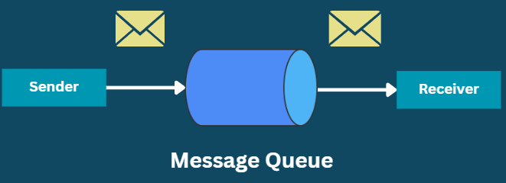
Point-to-Point Messaging System
Messages are persisted in a queue.
One or more consumers can consume the messages in the queue;
A particular message can be consumed by one consumer only.
Once a consumer reads a message in the queue, it disappears from that queue.

Slide 18
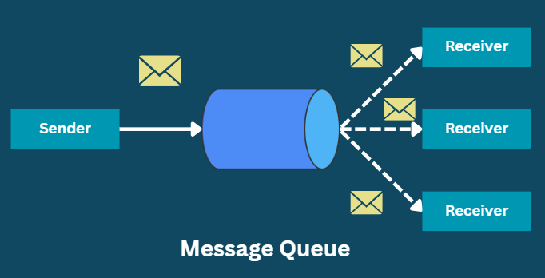
Publish-Subscribe Messaging System
Messages are persisted in a topic.
Consumers can subscribe to multiple topics and consume all the messages.
Message producers are called publishers.
Message consumers are called subscribers.

Slide 19
Streaming Process

Slide 20
Streaming Process
Processing of data in parallelly connected systems.
Allows different applications to limit the parallel execution of the data, where one record executes without waiting for the output of the previous record.
Therefore, a distributed streaming platform enables the user to simplify the task of streaming process and parallel execution.

Slide 21

Streaming Process
Producers
App
App
App
App
Kafka Cluster
Stream Processors
Connectors
App
App
App
App
Consumers

Slide 22
Topics and Partitions

Slide 23
Topics
A stream of messages belonging to a particular category is called a topic.
Data is stored in topics.
Topics are split into partitions.
Similar to tables in the database, but not containing all constraints.
Any number of topics can be created.
A producer publishes data to the topics;
A consumer reads that data from the topic by subscribing it.

Slide 24
Partitions
A topic is split into several parts which are known as the partitions.
These partitions are separated in an order.
The data content gets stored in the partitions within the topic.
Topics may have many partitions, so it can handle an arbitrary amount of data.
Each message gets stored into partitions with an incremental id known as its Offset value.

Slide 25
How are Partitions Replicated?
Replicas are backups of partitions.
These are never read data or write data.
This means that we don’t directly read or write data to the replicas.
We read and write the data only on the partitions and that is replicated to the replicas.

Slide 26
How are Partitions Replicated?
My Topic
Partition 1
R (Partition 1)
R (Partition 2)
Partition 2
Partition 3
R (Partition 3)
Partition: 3
Replication Factor: 2
Broker 1
Broker 2

Slide 27
How are Partitions Replicated?
My Topic
Partition 1
R (Partition 1)
R (Partition 1)
R (Partition 2)
Partition 2
R(Partition 2)
R(Partition 3)
R(Partition 3)
Partition 3
Partition: 3
Replication Factor: 3
Broker 1
Broker 2
Broker 3

Slide 28
Brokers

Slide 29
Kafka Brokers
A Kafka cluster is comprised of one or more servers which are “brokers”.
Each broker may have zero or more partitions per topic.
Assume, if there are N partitions in a topic and N number of brokers, each broker will have one partition.
Broker
Topic
Partition-0
Partition-1
:
Partition-n

Slide 30
Cluster

Slide 31
Kafka Cluster
Kafka’s having more than one broker are called as Kafka cluster.
Can be expanded without downtime.
Used to manage the persistence and replication of message data.
Single Broker Cluster: Having only one broker is called Single Broker Cluster.
Multi-Broker Cluster: Having two or more brokers is called Multi-Broker Cluster.

Slide 32
Kafka Cluster
Broker 1
Topic A
Partition 0
Broker 2
Producer
Consumer
Topic B
Partition 1
Broker 3
Topic B
Partition 0

